Slide 1
Obedience to authority, including Milgram’s work and explanations of why people obey
Part 2
Introduction

Slide 2
Milgram
One of the most famous studies of obedience in psychology was carried out by Stanley Milgram (1963).
Stanley Milgram, a psychologist at Yale University, conducted an experiment focusing on the conflict between obedience to authority and personal conscience.
He examined justifications for acts of genocide offered by those accused at the World War II, Nuremberg War Criminal trials. Their defence often was based on "obedience" - that they were just following orders from their superiors.
The experiments began in July 1961, a year after the trial of Adolf Eichmann in Jerusalem. Milgram devised the experiment to answer the question "Could it be that Eichmann and his million accomplices in the Holocaust were just following orders? Could we call them all accomplices?" (Milgram, 1974).

Slide 3
Notes
Milgram study in obedience
Yale University
I was just following orders - World War II, Nuremberg War Criminal trials.

Slide 4
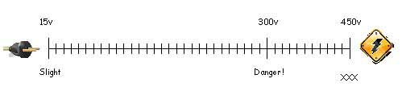
Milgram (1963) wanted to investigate whether Germans were particularly obedient to authority figures as this was a common explanation for the Nazi killings in World War II.
Milgram selected participants for his experiment by newspaper advertising for male participants to take part in a study of learning at Yale University. The procedure was that the participant was paired with another person and they drew lots to find out who would be the ‘learner’ and who would be the ‘teacher’. The draw was fixed so that the participant was always the teacher, and the learner was one of Milgram’s confederates (pretending to be a real participant).
The learner (a confederate called Mr. Wallace) was taken into a room and had electrodes attached to his arms, and the teacher and researcher went into a room next door that contained an electric shock generator and a row of switches marked from 15 volts (Slight Shock) to 375 volts (Danger: Severe Shock) to 450 volts (XXX).

Slide 5
Notes
Newspaper advertising for male participants to take part in a study of learning at Yale University.
Teacher (Person who does not know), Learner (Confederate, electrocuted), Researcher (gives commands/prods)
15 volts (Slight Shock) to 375 volts (Danger: Severe Shock) to 450 volts (XXX).

Slide 6
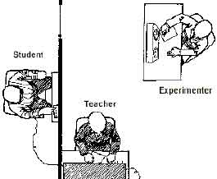

Slide 7
Experiment
There was also an “experimenter” dressed in a grey lab coat, played by an actor (not Milgram).
Two rooms in the Yale Interaction Laboratory were used - one for the learner (with an electric chair) and another for the teacher and experimenter with an electric shock generator.
The “learner” (Mr. Wallace) was strapped to a chair with electrodes. After he has learned a list of word pairs given him to learn, the "teacher" tests him by naming a word and asking the learner to recall its partner/pair from a list of four possible choices.

Slide 8
Experiment
The teacher is told to administer an electric shock every time the learner makes a mistake, increasing the level of shock each time. There were 30 switches on the shock generator marked from 15 volts (slight shock) to 450 (danger – severe shock).
The learner gave mainly wrong answers (on purpose) and for each of these the teacher gave him an electric shock. When the teacher refused to administer a shock the experimenter was to give a series of orders / prods to ensure they continued. There were 4 prods and if one was not obeyed then the experimenter (Mr. Williams) read out the next prod, and so on.
Prod 1: please continue.
Prod 2: the experiment requires you to continue.
Prod 3: It is absolutely essential that you continue.
Prod 4: you have no other choice but to continue.

Slide 9
Notes
Learner (confederate) gives wrong answers = electric shock.
Prods *4 given by the experimenter.
  prod 1: please continue.
  Prod 2: the experiment requires you to continue.
  Prod 3: It is absolutely essential that you continue.
  Prod 4: you have no other choice but to continue.

Slide 10
Results
65% (two-thirds) of participants (i.e. teachers) continued to the highest level of 450 volts. All the participants continued to 300 volts.
Milgram did more than one experiment – he carried out 18 variations of his study. All he did was alter the situation (IV) to see how this affected obedience (DV).

Slide 11
Notes
All to 300 Vaults (ouch) 65% to 450 (lethal)

Slide 12
Conclusion
Ordinary people are likely to follow orders given by an authority figure, even to the extent of killing an innocent human being. Obedience to authority is ingrained in us all from the way we are brought up.
People tend to obey orders from other people if they recognize their authority as morally right and / or legally based. This response to legitimate authority is learned in a variety of situations, for example in the family, school and workplace.

Slide 13
Notes
Obedience to authority is ingrained
recognize their authority. Ingrained by our experiences eg: teachers, parents, work

Slide 14
Milgram himself!
“The Perils of Obedience” (Milgram 1974), writing:
“The legal and philosophic aspects of obedience are of enormous import, but they say very little about how most people behave in concrete situations. I set up a simple experiment at Yale University to test how much pain an ordinary citizen would inflict on another person simply because he was ordered to by an experimental scientist. Stark authority was pitted against the subjects’ [participants’] strongest moral imperatives against hurting others, and, with the subjects’ [participants’] ears ringing with the screams of the victims, authority won more often than not. The extreme willingness of adults to go to almost any lengths on the command of an authority constitutes the chief finding of the study and the fact most urgently demanding explanation.”

Slide 15
Milgram’s Agency Theory
Milgram (1974) explained the behaviour of his participants by suggesting that people actually have two states of behaviour when they are in a social situation:
The autonomous state – people direct their own actions, and they take responsibility for the results of those actions.
The agentic state – people allow others to direct their actions, and then pass off the responsibility for the consequences to the person giving the orders. In other words, they act as agents for another person’s will.

Slide 16
Notes
Milgram Agency theory
two states of behaviour when they are in a social situation
  autonomous state responsibility for own actions
  agentic state (agent) agent of somebody else. (take orders)

Slide 17
And
Milgram suggested that two things must be in place in order for a person to enter the agentic state:
The person giving the orders is perceived as being qualified to direct other people’s behavior. That is, they are seen as legitimate.
The person being ordered about is able to believe that the authority will accept responsibility for what happens.
Agency theory says that people will obey an authority when they believe that the authority will take responsibility for the consequences of their actions. This is supported by some aspects of Milgram’s evidence. For example, when participants were reminded that they had responsibility for their own actions, almost none of them were prepared to obey. In contrast, many participants who were refusing to go on did so if the experimenter said that he would take responsibility.

Slide 18
Notes
Milgram Agency theory
two states of behaviour when they are in a social situation
  autonomous state responsibility for own actions
  agentic state (agent) agent of somebody else. (take orders)
    Authority is seen as legitimate
    Belief authority will accept responsibility for what happens
When Milgram told the teachers that they were responsible almost none complied to the prods.

Slide 19
Critical Evaluation
The Milgram studies were conducted in laboratory type conditions and we must ask if this tells us much about real-life situations. We obey in a variety of real-life situations that are far more subtle than instructions to give people electric shocks, and it would be interesting to see what factors operate in everyday obedience. The sort of situation Milgram investigated would be more suited to a military context.
Orne & Holland (1968) accused Milgram’s study of lacking ‘experimental realism’, i.e. participants might not have believed the experimental set-up they found themselves in and knew the learner wasn’t really receiving electric shocks.

Slide 20
Notes
Laboratory
Orne & Holland (1968) accused Milgram’s study of lacking ‘experimental realism’ ie the participants knew it was an experiment.

Slide 21
Critical Evaluation
Milgram's sample was biased:
The participants in Milgram's study were all male. Do the findings transfer to females?
Milgram’s study cannot be seen as representative of the American population as his sample was self-selected. This is because they became participants only by electing to respond to a newspaper advertisement (selecting themselves). They may also have a typical "volunteer personality" – not all the newspaper readers responded so perhaps it takes this personality type to do so.
Yet a total of 636 participants were tested in 18 separate experiments across the New Haven area, which was seen as being reasonably representative of a typical American town.

Slide 22
Notes
all male
sample was self-selected ‘volunteer personality’
One area ‘New Haven’

Slide 23
Critical Evaluation
Milgram’s findings have been replicated in a variety of cultures and most lead to the same conclusions as Milgram’s original study and in some cases see higher obedience rates.
However, Smith & Bond (1998) point out that with the exception of Jordan (Shanab & Yahya, 1978), the majority of these studies have been conducted in industrialized Western cultures and we should be cautious before we conclude that a universal trait of social behaviour has been identified.

Slide 24
Notes
Study has been replicated
Smith & Bond (1998) point out most (not all) are western.

Slide 25
Ethical Issues

Slide 26
Deception
The participants actually believed they were shocking a real person, and were unaware the learner was a confederate of Milgram's.
However, Milgram argued that “illusion is used when necessary in order to set the stage for the revelation of certain difficult-to-get-at-truths”.
Milgram also interviewed participants afterwards to find out the effect of the deception. Apparently 83.7% said that they were “glad to be in the experiment”, and 1.3% said that they wished they had not been involved.

Slide 27
Protection of participants
Participants were exposed to extremely stressful situations that may have the potential to cause psychological harm. Many of the participants were visibly distressed.
Signs of tension included trembling, sweating, stuttering, laughing nervously, biting lips and digging fingernails into palms of hands. Three participants had uncontrollable seizures, and many pleaded to be allowed to stop the experiment.
In his defence, Milgram argued that these effects were only short term. Once the participants were debriefed (and could see the confederate was OK) their stress levels decreased. Milgram also interviewed the participants one year after the event and concluded that most were happy that they had taken part.

Slide 28
Notes
Deception
Stressful
They were debriefed and followed up a year after.

Slide 29
Debriefing!
However, Milgram did debrief the participants fully after the experiment and also followed up after a period of time to ensure that they came to no harm.
Milgram debriefed all his participants straight after the experiment and disclosed the true nature of the experiment. Participants were assured that their behaviour was common and Milgram also followed the sample up a year later and found that there were no signs of any long term psychological harm. In fact the majority of the participants (83.7%) said that they were pleased that they had participated.

Slide 30
Right to Withdraw
The BPS states that researchers should make it plain to participants that they are free to withdraw at any time (regardless of payment).
Did Milgram give participants an opportunity to withdraw? The experimenter gave four verbal prods which essentially discouraged withdrawal from the experiment:
  Please continue.
  The experiment requires that you continue.
  It is absolutely essential that you continue.
  You have no other choice, you must go on.
Milgram argued that they are justified as the study was about obedience so orders were necessary. Milgram pointed out that although the right to withdraw was made partially difficult it was possible as 35% of participants had chosen to withdraw.

Slide 31
Milgram Variations.
The Milgram experiment was carried out many times whereby Milgram varied the basic procedure (changed the IV). By doing this Milgram could identify which factors affected obedience (the DV). Obedience was measured by how many participants shocked to the maximum 450 volts (65% in the original study).
In total 636 participants have been tested in 18 different variation studies.

Slide 32
Notes
Changed the IV.
Kept DV the same as in Obedience.

Slide 33
Change of Location Condition
The experiment was moved to a set of run down offices rather than the impressive Yale University.
Obedience dropped to 47.5%.
This suggests that status of location effects obedience.

Slide 34
Notes
Run down Location. Less obedience
This suggests that status of location effects obedience.

Slide 35
Two Teacher Condition
When there is less personal responsibility obedience increases.
When participants could instruct an assistant (confederate) to press the switches, 92.5% shocked to the maximum 450 volts.
This relates to Milgram's Agency Theory.
Note above

Slide 36
Touch Proximity Condition
The teacher had to force the learner's hand down onto a shock plate when they refuse to participate after 150 volts.
Obedience fell to 30%.
The participant is no longer buffered / protected from seeing the consequences of their actions.
Note above

Slide 37
Uniform Condition
Milgram’s experimenter wore a laboratory coat (a symbol of scientific expertise) which gave him a high status.
But when the experimenter dressed in everyday clothes obedience was very low.
The uniform of the authority figure can give them status.
Note above

Slide 38
Social Support Condition
Two other participants (confederates) were also teachers but refused to obey.
Confederate 1 stopped at 150 volts and confederate 2 stopped at 210 volts.
The presence of others who are seen to disobey the authority figure reduces the level of obedience to 10%.
Note above

Slide 39
Absent Experimenter Condition
Authority figure distant. It is easier to resist the orders from an authority figure if they are not close by.
When the experimenter instructed and prompted the teacher by telephone from another room, obedience fell to 20.5%.
Many participants cheated and missed out shocks or gave less voltage than ordered to by the experimenter.
Proximity of authority figure effects obedience.
Note above

Slide 40
Notes
Two Teacher Condition - agency theory more
Touch Proximity Condition - involvement Less
Uniform Condition – Lab coat more normal less
Social Support Condition – less
Absent Experimenter Condition - less

Slide 41
Another
Stanford Prison Experiment
Conclusion: People will readily conform to the social roles they are expected to play, especially if the roles are as strongly stereotyped as those of the prison guards. The “prison” environment was an important factor in creating the guards’ brutal behaviour (none of the participants who acted as guards showed sadistic tendencies before the study). Therefore, the roles that people play can shape their behaviour and attitudes.

Slide 42
Gradual commitment
If people start small then it is easier to do something bad. In Milgram’s original electric shock experiment (Milgram, 1963), participants started by administering a 15 volt shock which was small and relatively harmless. The shock levels gradually increased in 15 volt increments and did not become dangerous or particularly painful until several shocks had been administered. Had participants been asked to deliver just one large shock, it is less likely that they would have done so, but since they had started small it was only a little step to the next shock, and another little step to the one after that and so on. People gradually commit to doing bad things. Perhaps Nazi soldiers gradually committed to their actions against the Jews by moving from name calling, through minor violent attacks, more serious attacks, to murder and ultimately mass extermination. It should be remembered that the task used in Milgram’s experiment lacked ecological validity, meaning that the findings should be treated with caution when using them as definitive explanations for obedience in real life situations.

Slide 43
Recap
Reasons why we obey
A likely exam question: Outline TWO psychological explanations for obedience (3+3 marks)

Slide 44
Legitimate Authority:
NAME: This explanation proposes that we obey authority figures because we respect their position and power, presuming that they know what they are doing. People obey when they recognise authority as being morally and/or legally based.
EXPLAIN: Legitimate social power is held by authority figures whose role is socially defined & determined e.g. doctors, political leaders, police personnel, etc…. this usually gives people the right to exert control over others & in turn results in others accepting this control (usually).
APPLY: Legitimate authority can clearly be seen in Milgram’s study in terms of the presence of the authority figure. For example the basic obedience rate in the original experiment was 65%, but significantly declined to 20.5% when the experimenter left the room and continued to give his instructions via the telephone.
EXTENSION: Legitimate authority can further be seen when we consider the physical environment as a legitimate situation, since the obedience rate of 65% (original experiment) dropped to 47.5% when the experiment was moved to a run down office block. Furthermore, the nurses in Hofling’s et al (1966) study claimed that the hierarchy within the medical professional disallows any dis-obedience towards a doctor (i.e. they know best).

Slide 45
Gradual Commitment:
NAME: Gradual commitment explains obedience in terms of the individual being asked to perform trivial, seemingly harmless tasks. Once the person has complied with such requests, they find it increasingly difficult to refuse to carry out more serious (& escalating) requests.
EXPLAIN: Milgram’s participants were encouraged to obey the experimenter by the gradual steps they were asked to take. They started with a practice session, then went on to take part in ‘the real thing’. The first ‘shock’ administered was ONLY 15 volts.
APPLY: Furthermore, each further ‘shock’ increased by ONLY 15 volts. This increase would seem less drastic than, for example, an increase from 15 volts to 450 volts.
EXTENSION: The first step in this psychological process is called ‘the foot in the door’ effect (Freedman & Fraser, 1966) and is explained by the desire to be consistent. The obedience observed by Meeus & Raajimaker (1982) further supports this, since the 15 ‘stress remarks’ given by the participant gradually increased in relation to their seriousness.

Slide 46
Buffers:
NAME: The term ‘buffer’ is used to refer ‘any aspect of a situation that protects people from having to confront the consequences of their actions’.
EXPLAIN: Buffers can readily be seen in Milgram’s experiment. For example, when the teacher and learner were in different rooms, the basic obedience rate was 65%. However, when they were in the same room (i.e. no physical buffer) the obedience rate dropped to 40%.
APPLY: Further buffers can be seen – for example, when the ‘teacher’ only asks the questions (& was therefore not responsible for actually administering the ‘shocks’) obedience rose dramatically to 92.5%. This can be explained in terms of a loss of responsibility.
EXTENSION: In real life situations, the person obeying may not even observe the results of their obedience, for example, during WW2, Adolf Eichmann (the angel of death) argued that he simply gave the order for millions of Jews to be exterminated, whilst never actually witnessing the consequences.

Slide 47
Agency Theory:
NAME: Milgram developed the agency theory to explain the psychological processes involved in obedience to authority – this proposes that people operate on TWO levels;
As autonomous individuals – behaving voluntarily & willing to take responsibility for their actions
As an agent – individuals believe themselves to being acting on the instructions of others, as an agent & are therefore NOT responsible for their own actions
EXPLAIN: Moving from the autonomous to the agentic level is called the ‘agentic shift’ & it is emphasised by the fact that people no longer see themselves as responsible for their actions – they obey orders from an authority figure (perhaps because of their legitimate authority) and therefore regard themselves as not being responsible. This is known as the ‘agentic state’.
APPLY: Participants in Milgram’s experiment could be seen as ‘agents’, particularly as the severity of the ‘shocks’ increased. For example, when the participant became increasingly strong, the experimenter proclaimed his responsibility for what happened to the ‘learner’. This may have allowed the ‘teacher’ to make the agentic shift away from autonomy.
EXTENSION: The agentic state is also observed in Hofling’s study, since the nurses explained their obedience using the ‘hierarchy’ of authority (and therefore responsibility) in hospitals. In a real life application, Louise Ogborn’s supervisor claimed to be acting purely upon the requests of the ‘police officer’.

Slide 48
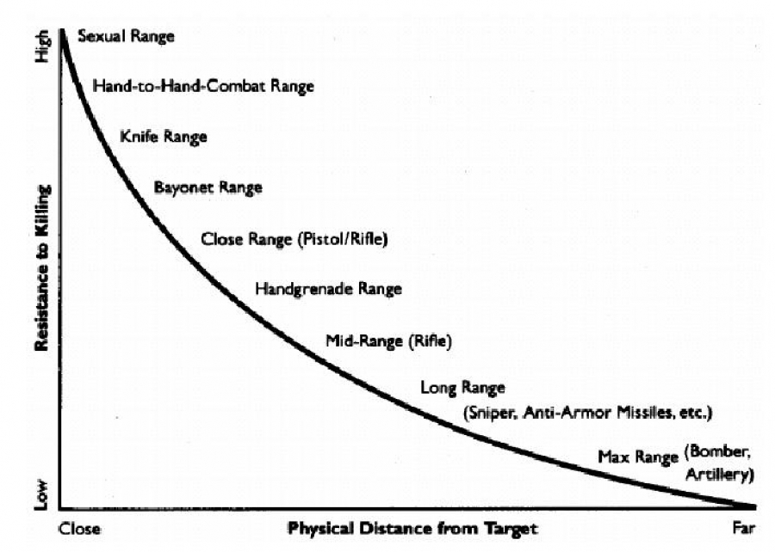

Slide 49
Drone Discussion
Watch
Agentic?
Buffers?
Gradual Commitment?

